Slide 1
TEACHING CREATIVE CRITICAL ACTION BEYOND ECONOMY INTO “the art of TECHNO-ECOLOGY”: Approaches in integrating technology ethics with STEM Art education
Jane Crayton
University of New Mexico
University of Colorado at Boulder
Notes:
Creative approaches for encouraging technology ethics and innovation in students using a STEM Art education philosophy.

Slide 2
STEM + Art
Creative critical action with STEM-A (Science, Technology, Engineering and Math through Art) is a philosophy which integrates exploration of STEM subjects through art inquiry. This approach to STEM education creates space for the instructor to include ethical, radical and inventive approaches to educating students.

Slide 3
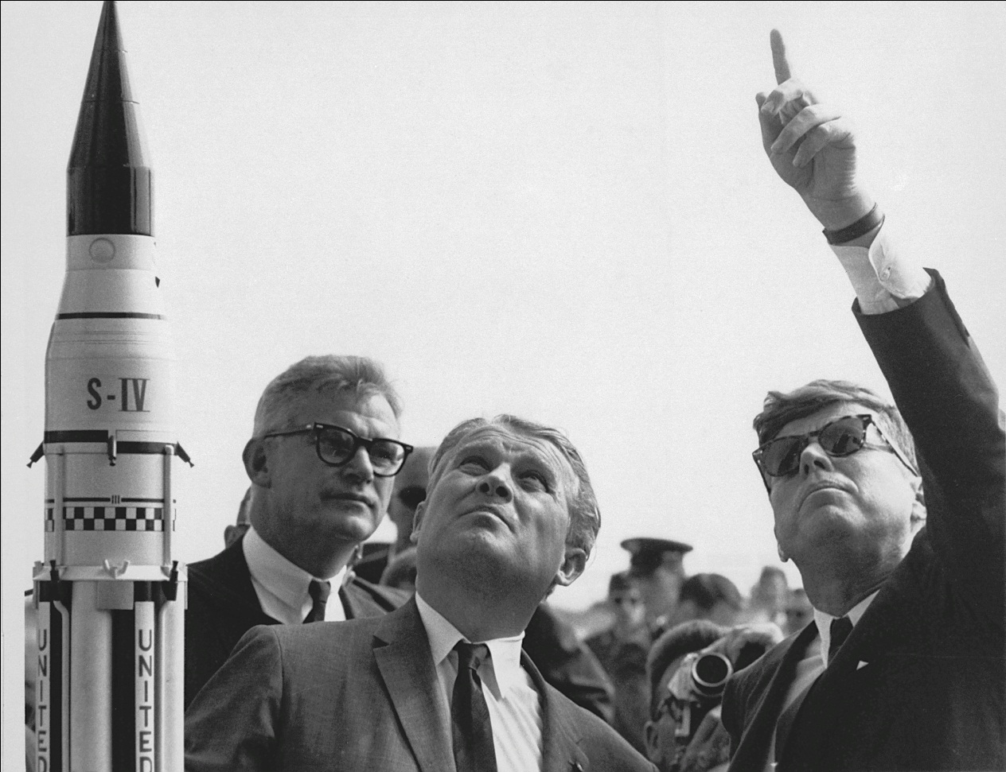
Innovation Nation
Innovation is the most prized human dexterity, and STEM education is a critical component of societies to produce innovative products.

Slide 4
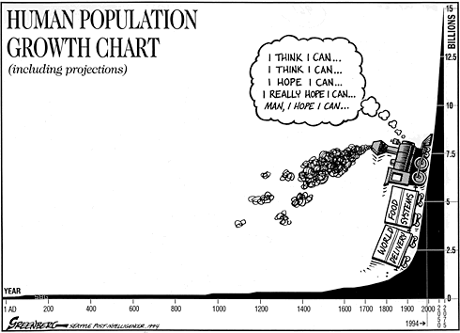
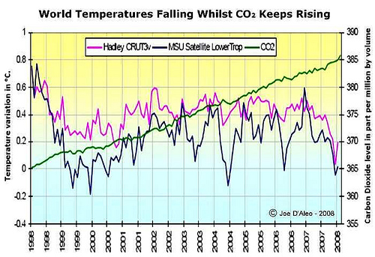
Global_ism
However as global economies emerge in our post-Google society, facing human impacted climate change, it is critical that we radically change the face of our education system and eventually our economies, to include a broader scope of STEM innovation.

Slide 5
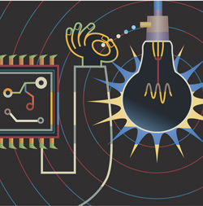
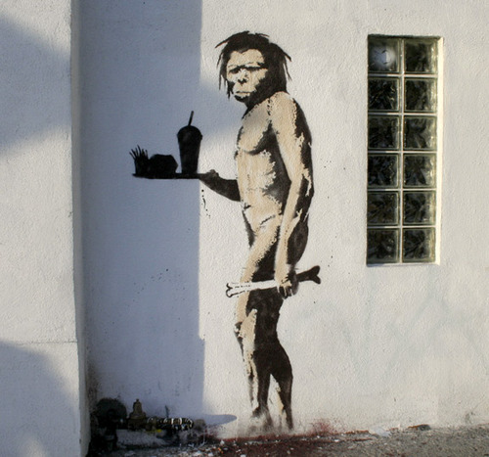
Inclusive solutions for humans
Art and diversity need to be included in STEM education to foster a sustainable community of ethical technologists who create solutions for humans beyond industry.

Slide 6
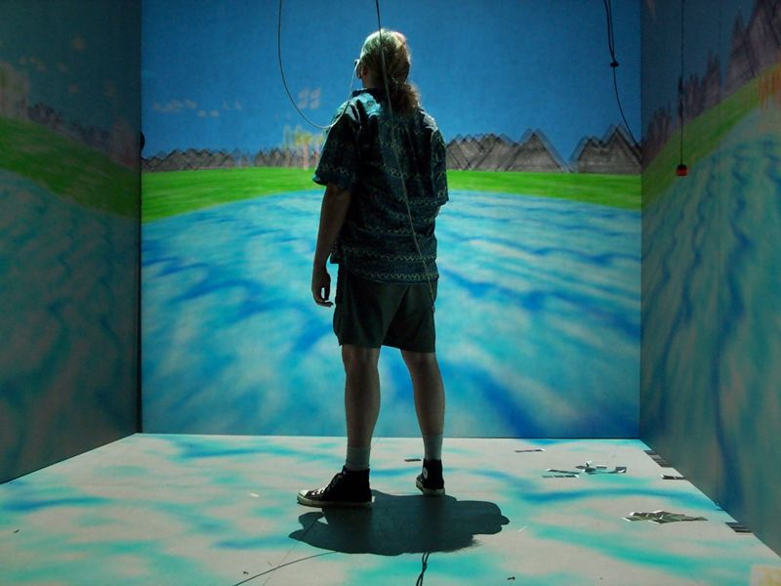
Next Generation Ethics
With the exploration of electronic arts, media and sciences, students gain valuable skills for using and working with complex STEM concepts, while integrating ethical, and critical thinking skills.

Slide 7
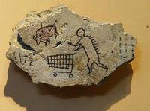
Critically Seeing
STEM acquired skills through artistic inquiry further the ability of users and creators to make educated decisions about innovative processes, products, or services; created or consumed.

Slide 8
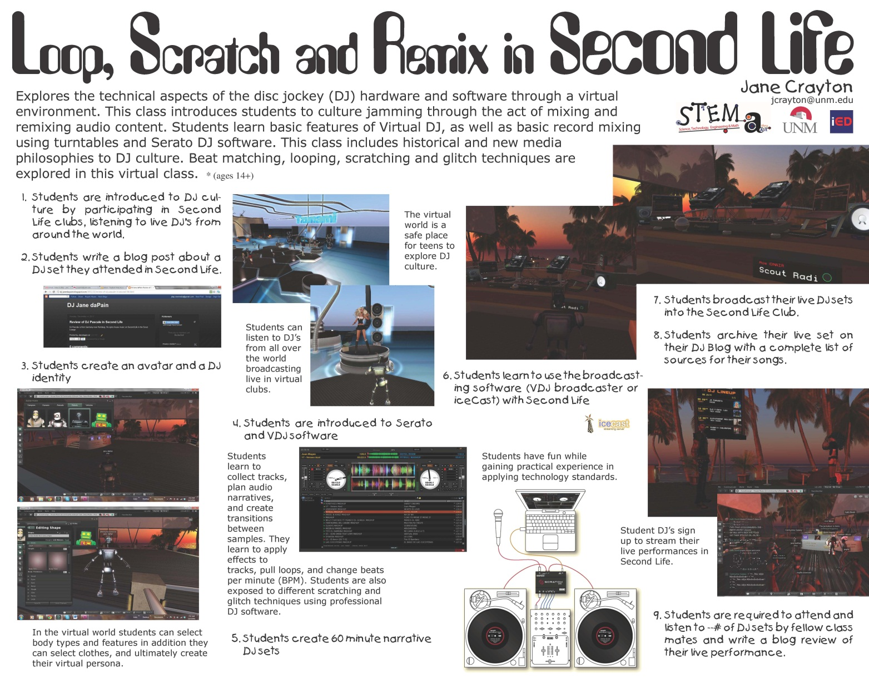
Implementation Problems
Safety
Politically Correct
Liability
How can we teach technology ethics, etiquette, and safety if students are protected from every potential threat.
Example: Loop, Scratch, Remix in Second Life is too dangerous for students…?

Slide 9
STEM + Art = Matters

Slide 10
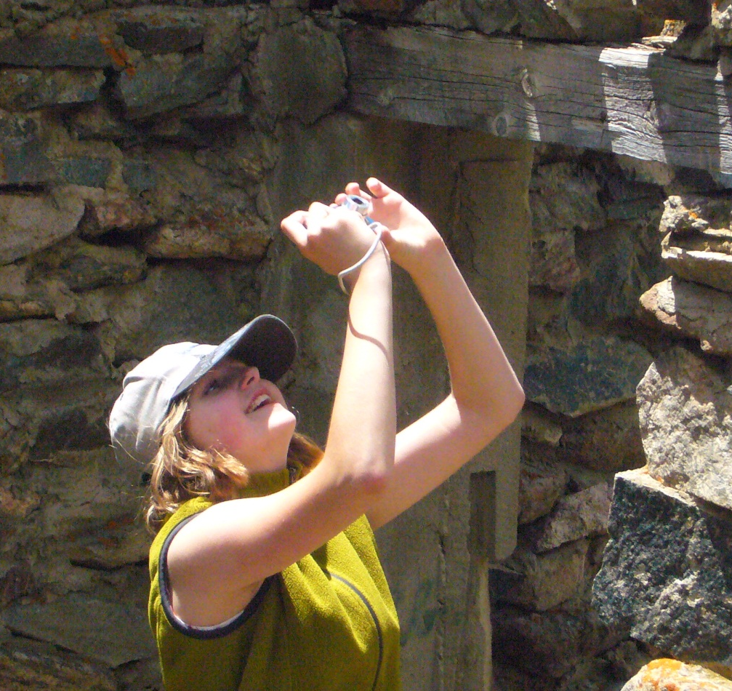
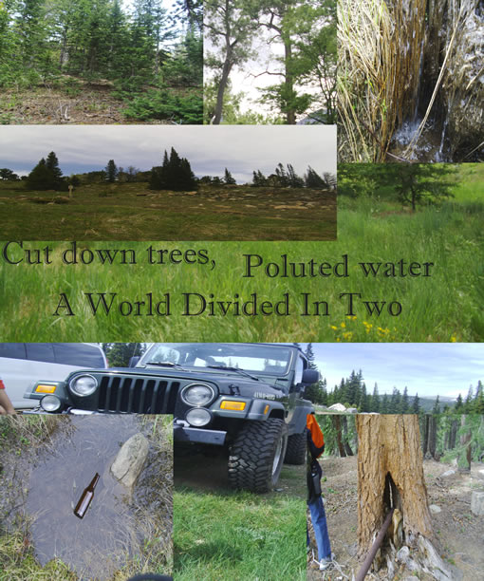
Digital Photography: Art of techno-ecology
Students create digital narratives about human impacts on the environment by exploring digital photography in the field and lab.

Slide 12
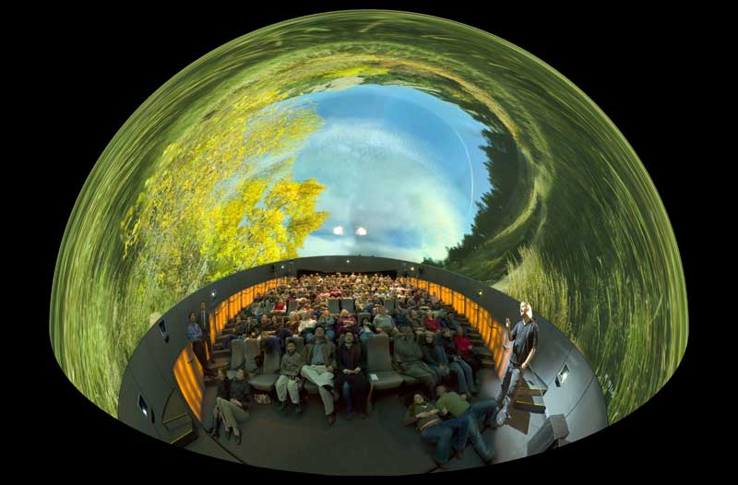
Immersive Landscapes: Digital Panoramic Photography for the fulldome
Students explore immersive environments through the fulldome, emphasizing environmental awareness, through the art of panoramic photography.

Slide 13
Immersive Landscapes: Student fulldome photography

Slide 14
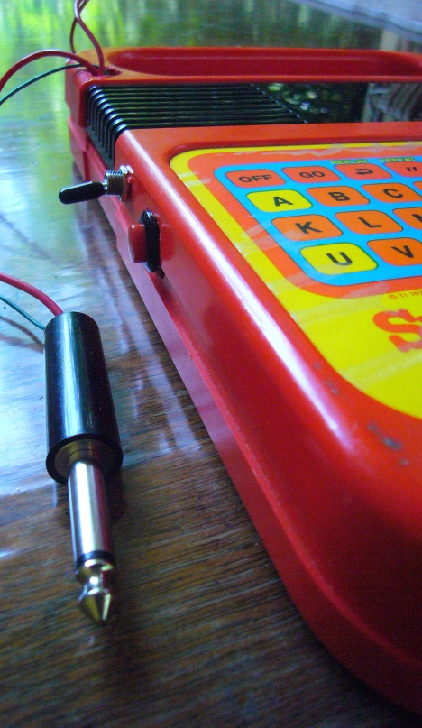
Circuit Bending
Yesterdays toys and discarded electronics are hacked, modified, and ‘bent’ (act of random short-circuiting) into low-voltage battery powered musical instruments.
Creative Critical Action
HACKING
Guerrilla
Culture jamming
Remixing
Re-Appropriation

Slide 15
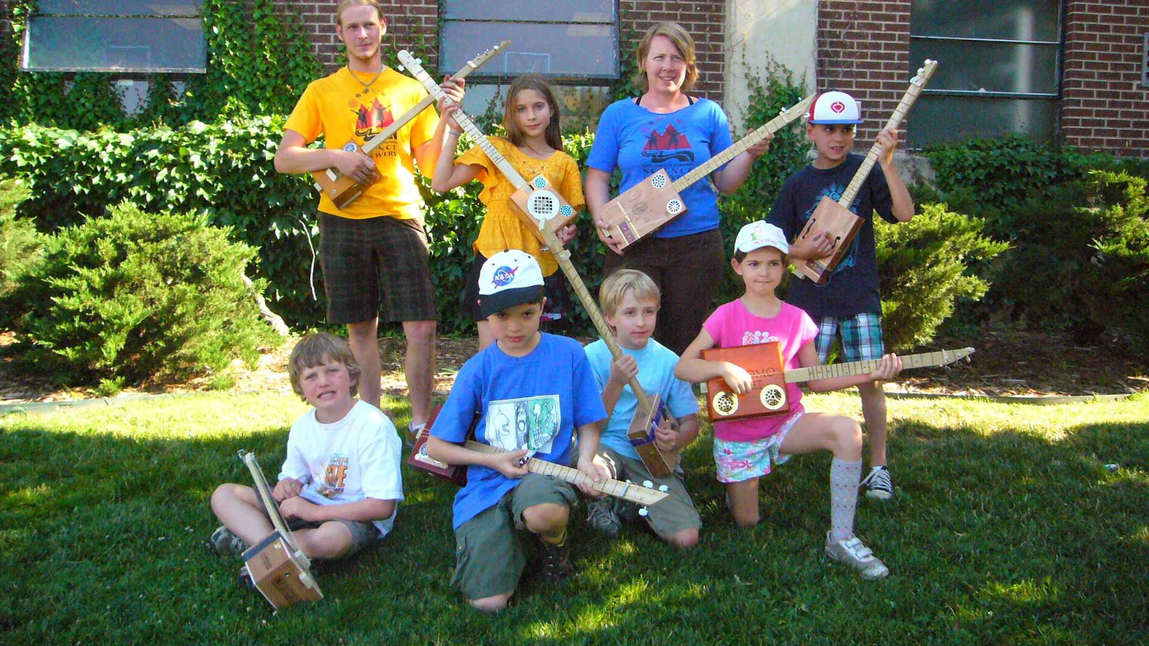
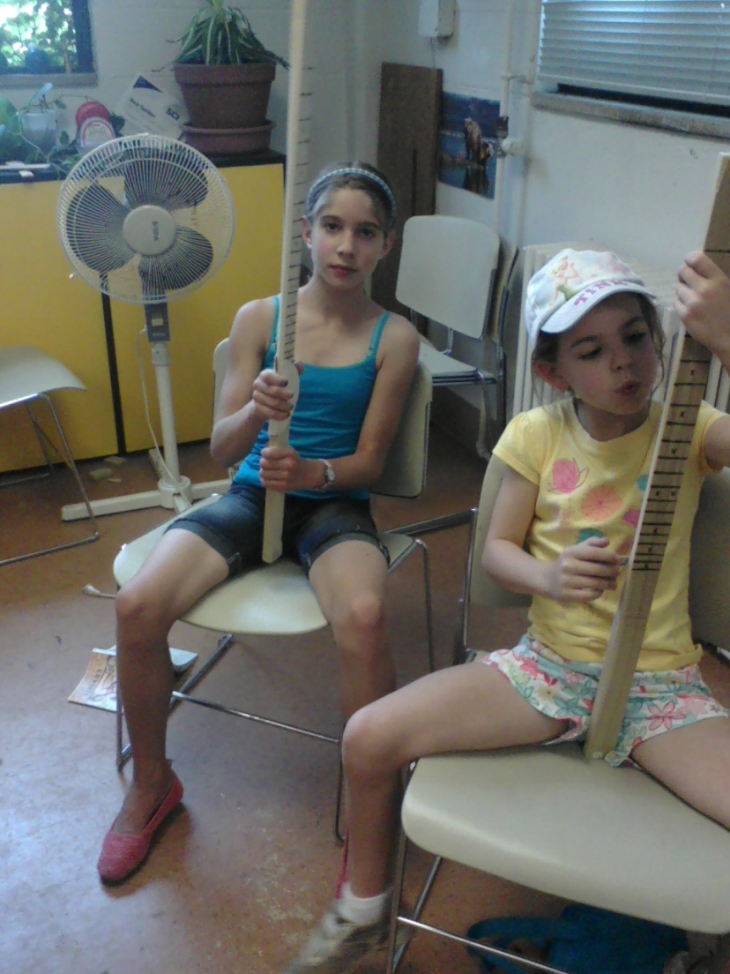
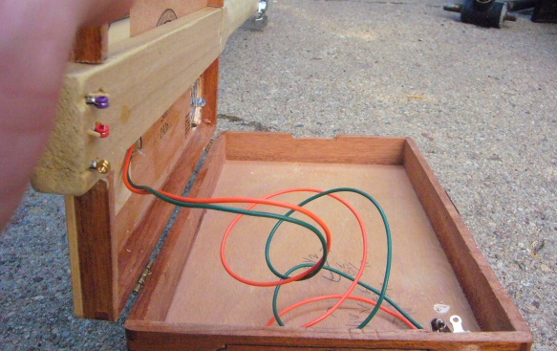
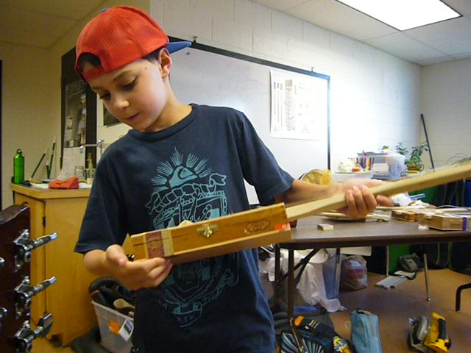
E-Instrumental: Electric cigarbox guitar and amp building
Resource
Reuse
DIY Technology
Electronics &
Audio Engineering

Slide 16
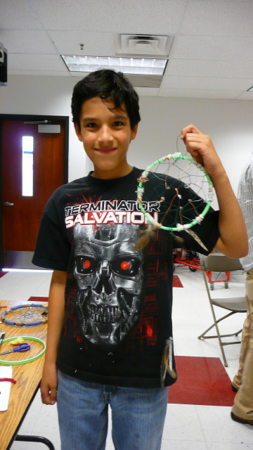
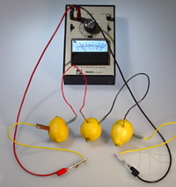
Citrus Circuits
Lemon Powered LED Dream catcher
Finding recycled materials (paper, material, wood, feathers, metals)
Metals, and natural materials as conductors (how many volts does a lemon have?)
History of Dream catchers/
Re-appropriating history and art.
Sustainable practices, alternative energy

Slide 17
http://stem-a.org
Jane Crayton
jcrayton@stem-a.org

